Slide 1

CHAPTER 18
Artificial Intelligence
Notes:
1.#

Slide 2
Objectives
After studying this chapter, the student should be able to:
Define and give a brief history of artificial intelligence.
Describe how knowledge is represented in an intelligent agent.
Show how expert systems can be used when a human expert is not available.
Show how an artificial agent can be used to simulate mundane tasks
performed by human beings.
Show how expert systems and mundane systems can use different search
techniques to solve problems.
Show how the learning process in humans can be simulated, to some extent,
using neural networks that create the electronic version of a neuron called a
perceptron.

Slide 3
18-1 INTRODUCTION
In this section we first try to define the term artificial intelligence (AI) informally and give a brief history of it. We also define an intelligent agent and its two broad
categories. Finally, we mention two programming languages that are commonly used in artificial intelligence.
18.<number>

Slide 4

18.1.1 What is artificial intelligence?
Although there is no universally-agreed definition of artificial intelligence, we accept the following definition that matches the topics covered in this chapter:
Artificial intelligence is the study of programmed systems that can simulate, to some extent, human activities such as perceiving, thinking, learning, and acting.

Slide 5
18.1.2 A brief history of artificial intelligence
Although artificial intelligence as an independent field of study is relatively new, it has some roots in the past. We can say that it started 2,400 years ago when the Greek philosopher Aristotle invented the concept of logical reasoning. The effort to finalize the language of logic continued with Leibniz and Newton. George Boole developed Boolean algebra in the nineteenth century (Appendix E) that laid the foundation of computer circuits. However, the main idea of a thinking machine came from Alan Turing, who proposed the Turing test. The term “artificial intelligence” was first coined by John McCarthy in 1956.

Slide 6
18.1.3 The Turing test
In 1950, Alan Turing proposed the Turing Test, which provides a definition of intelligence in a machine. The test simply compares the intelligent behavior of a human being with that of a computer. An interrogator asks a set of questions that are forwarded to both a computer and a human being. The interrogator receives two sets of responses but does not know which set comes from the human and which set from the computer. After careful examination of the two sets, if the interrogator cannot definitely tell which set has come from the computer and which from the human, the computer has passed the Turing test for intelligent behavior.

Slide 7
18.1.4 Intelligent agents
An intelligent agent is a system that perceives its environment, learns from it, and interacts with it intelligently. Intelligent agents can be divided into two broad categories: software agents and physical agents.
Software agents
A software agent is a set of programs that are designed to do particular tasks. For example, a software agent can check the contents of received e-mails and classifying them into different categories (junk, less important, important, very important, and so on). Another example of a software agent is a search engine used to search the World Wide Web and find sites that can provide information about a requested subject.

Slide 8
Physical agents
A physical agent (robot) is a programmable system that can be used to perform a variety of tasks. Simple robots can be used in manufacturing to do routine jobs such as assembling, welding, or painting. Some organizations use mobile robots that do routine delivery jobs such as distributing mail or correspondence to different rooms. Mobile robots are used underwater to prospect for oil. A humanoid robot is an autonomous mobile robot that is supposed to behave
like a human.

Slide 9
18.1.5 Programming languages
Although some all-purpose languages such as C, C++, and Java are used to create intelligent software, two languages are specifically designed for AI: LISP and PROLOG.
LISP
LISP (LISt Programming) was invented by John McCarthy in 1958. As the name implies, LISP is a programming language that manipulates lists.
PROLOG
PROLOG (PROgramming in LOGic) is a language that can build a database of facts and a knowledge base of rules. A program in PROLOG can use logical reasoning to answer questions that can be inferred from the knowledge base.

Slide 10
18-2 KNOWLEDGE REPRESENTATION
If an artificial agent is supposed to solve some problems related to the real world, it needs to be able to represent knowledge somehow. Facts are represented as data structures that can be manipulated by programs stored inside the computer. In this section, we describe four common methods for representing knowledge: semantic networks, frames, predicate logic, and rule-based systems.

Slide 11
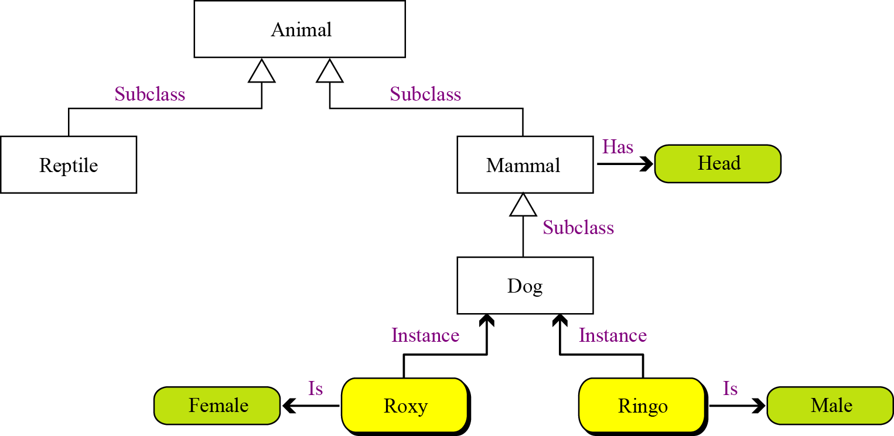
18.2.1 Semantic networks
A semantic network uses directed graphs to represent knowledge. A directed graph as discussed in Chapter 12 is made of vertices (nodes) and edges (arcs).
Figure 18.1 A simple semantic network
Notes:
Mạng ngữ nghĩa
Biểu đồ có hướng sử dụng định thức thể hiện ngữ nghĩa

Slide 12
Concepts
A concept can be thought of as a set or a subset. For example, animal defines the set of all animals, horse defines the set of all horses and is a subset of the set animal.
Relations
In a semantic network, relations are shown by edges. An edge can define a subclass relation, an instance relation attribute, an object (color, size, …), or a property of an object.

Slide 13
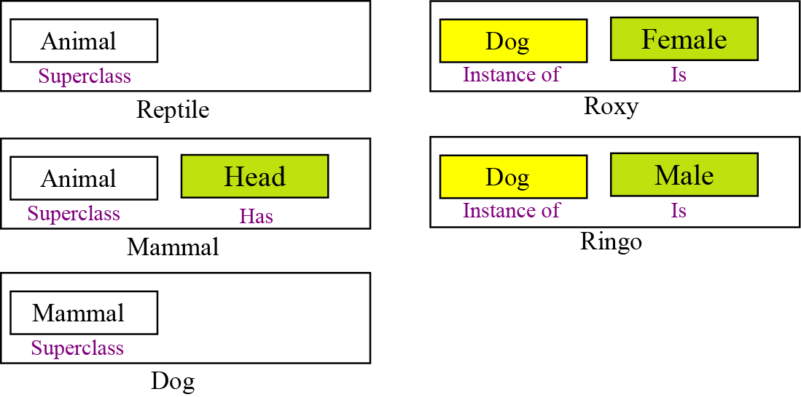
18.2.2 Frames
Frames are closely related to semantic networks. In frames, data structures (records) are used to represent the same knowledge. One advantage of frames over semantic networks is that programs can handle frames more easily than semantic networks.
Figure 18.2 A set of frames representing the semantic network

Slide 14
Objects
A node in a semantic network becomes an object in a set of frames, so an object can define a class, a subclass, or an instance of a class. In Figure 18.2, reptile, mammal, dog, Roxy, and Ringo are objects.
Slots
Edges in semantic networks are translated into slots—fields in the data structure. The name of the slot defines the type of the relationship and the value of the slot completes the relationship. In Figure 18.2, for example, animal is a slot in the reptile object.

Slide 15
18.2.3 Predicate logic
The most common knowledge representation is predicate logic. Predicate logic can be used to represent complex facts. It is a well-defined language developed via a long history of theoretical logic. Although this section defines predicate logic, we first introduce propositional logic, a simpler language. We then discuss predicate logic, which employs propositional logic.
¬ ∨∧→ ↔
(not) (or) (and) (if … then) (if and only if)
Notes:
Logic tuyến tính

Slide 16
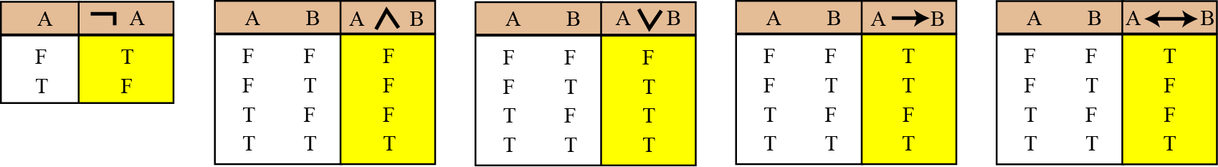
Propositional logic
Propositional logic is a language made up from a set of sentences that can be used to carry out logical reasoning about the world. Propositional logic uses five operators.
Figure 18.3 Truth table for five operators in propositional logic
Notes:
Logic mệnh đề

Slide 17
A sentence in this language is defined recursively as shown below:
An uppercase letter, such as A, B, S, or T, that represents a statement in a natural languages, is a sentence.
Any of the two constant values (true and false) is a sentence.
If P is a sentence, then ¬P is a sentence.
If P and Q are sentences, then P ∧ Q, P ∨ Q, P → Q, and P ↔ Q are sentences.

Slide 18
Example 18.1
The following are sentences in propositional language:
Today is Sunday (S).
It is raining (R).
Today is Sunday or Monday (S ∨ M).
It is not raining (¬ R).
If a dog is a mammal then a cat is a mammal (D → C).

Slide 19
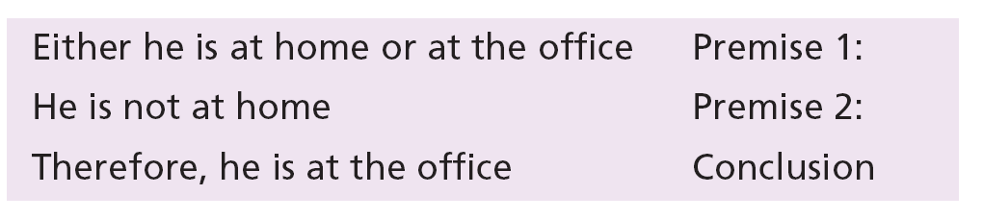

In AI we need to create new facts from the existing facts. In propositional logic, the process is called deduction. Given two presumably true sentences, we can deduce a new true sentence. For example:
If we use H for “he is at home”, O for “he is at office”, and the symbol |– for the “therefore”, then we can show the above argument as:

Slide 20
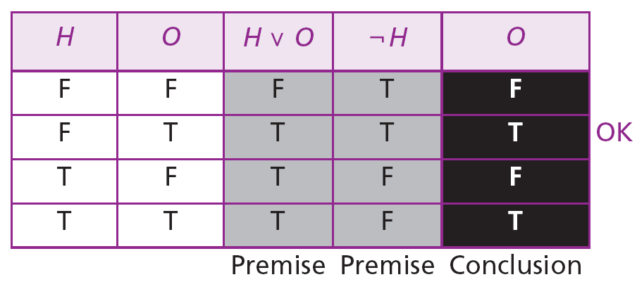
Example 18.2
The validity of the argument {H ∨ O, ¬H} |− O can be proved using the following truth table:
The only row to be checked is the second row. This row does not show a counterexample, so the argument is valid.

Slide 21
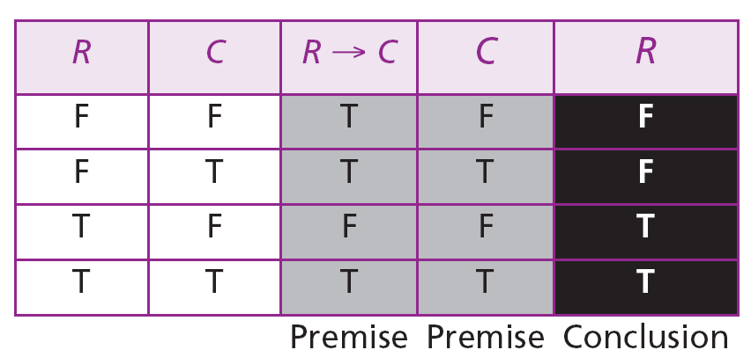

Example 18.3
The argument {R → C, C} |− R is not valid because a counter example can be found:
Here row 2 and row 4 need to be checked. Although row 4 is ok, row 2 shows a counterexample (two true premisses result in a false conclusion). The argument is therefore invalid.
An argument is valid if no counterexample can be found.

Slide 22
Predicate logic
In propositional logic, a symbol that represents a sentence is atomic: it cannot be broken up to find information about its components. For example, consider the sentences:
We can combine these two sentences in many ways to create other sentences, but we cannot extract any relation between Linda and Anne. For example, we cannot infer from the above two sentences that Linda is the grandmother of Anne. To do so, we need predicate logic: the logic that defines the relation between the parts in a proposition.

Slide 23
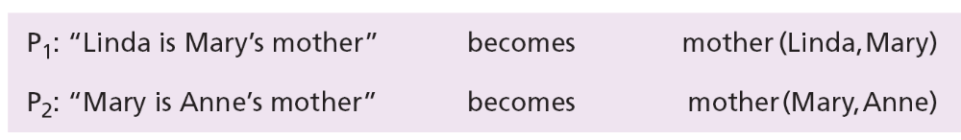
In predicate logic, a sentence is divided into a predicate and arguments. For example, each of the following propositions can be written as predicates with two arguments:
The relationship of motherhood in each of the above sentences is defined by the predicate mother. If the object Mary in both sentences refers to the same person, we can infer a new relation between Linda and Anne:
grandmother (Linda, Anne)

Slide 24
A sentence in predicate language is defined as follows:
A predicate with n arguments is a sentence.
Any of the two constant values (true and false) is a sentence.
If P is a sentence, then ¬P is a sentence.
If P and Q are sentences, then P ∧ Q, P ∨ Q, P → Q, and
P ↔ Q are sentences.

Slide 25
Example 18.4
The sentence “John works for Ann’s sister” can be written as:
Works[John, sister(Ann)]
The sentence “John’s father loves Ann’s sister” can be written as:
loves[father(John), sister(Ann)]

Slide 26
Predicate logic
Predicate logic allows us to use quantifiers. Two quantifiers are common in predicate logic:
∀ and ∃
The first, which is read as “for all”, is called the universal quantifier: it states that something is true for every object that its variable represents.
The second, which is read as “there exists”, is called the existential quantifier: it states that something is true for one or more objects that its variable represents.

Slide 27

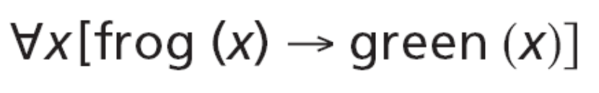

Example 18.5
The sentence “All men are mortals” can be written as:
The sentence “Frogs are green” can be written as:
The sentence “Some flowers are red” can be written as:

Slide 28
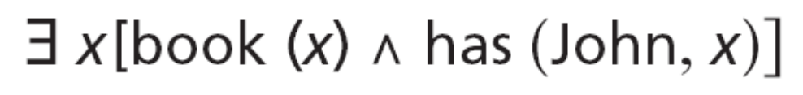

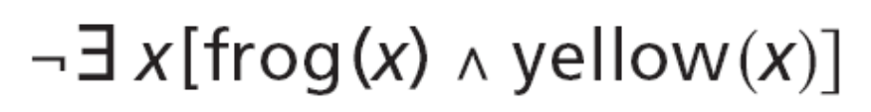
The sentence “John has a book” can be written as:
The sentence “No frog is yellow” can be written as:
or

Slide 29
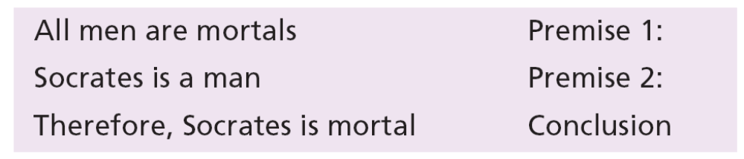
Deduction
In predicate logic, if there is no quantifier, the verification of an argument is the same as that which we discussed in propositional logic. However, the verification becomes more complicated if there are quantifiers. For example, the following argument is completely valid.
Verification of this simple argument is not difficult. We can write this argument as shown next:

Slide 30
Since the first premise talks about all men, we can replace one instance of the class man (Socrates) in that premiss to get the following argument:
Which is reduced to M1 → M2, M1 |− M2, in which M1 is man(Socrates) and M2 is mortal(Socrates). The result is an argument in propositional logic and can be easily validated.

Slide 31
Beyond predicate logic
There have been further developments in logic to include the need for logical reasoning. Some examples of these include high-order logic, default logic, modal logic, and temporal logic.

Slide 32
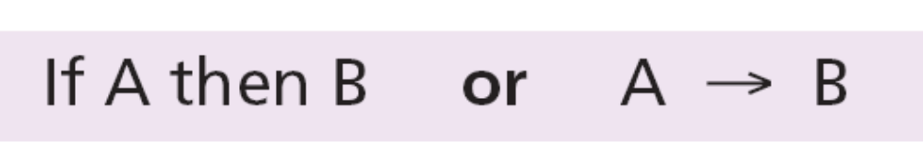
18.2.4 Rule-based systems
A rule-based system represents knowledge using a set of rules that can be used to deduce new facts from known facts. The rules express what is true if specific conditions are met. A rule-based database is a set of if… then… statements in the form
in which A is called the antecedent and B is called the consequent. Note that in a rule-based system, each rule is handled independently without any connection to other rules.

Slide 33
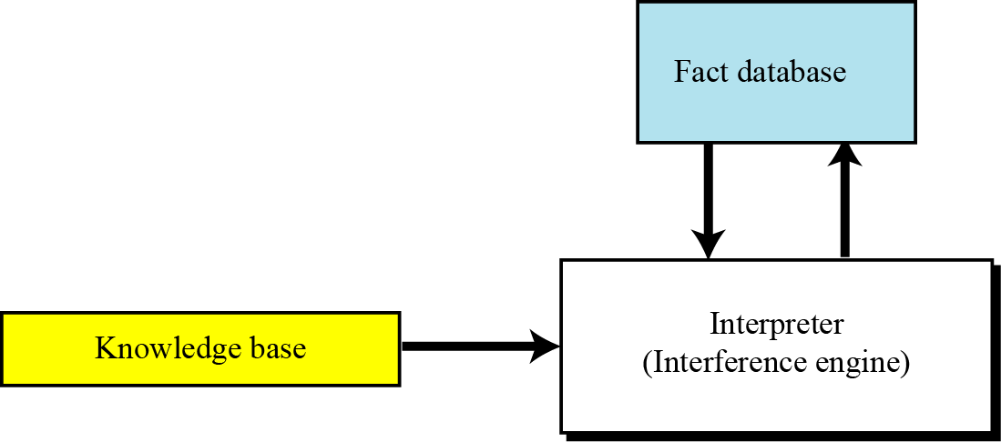
Components
A rule-based system is made up of three components: an interpreter (or inference engine), a knowledge base, and a fact database, as shown in Figure 18.4.
Figure 18.4 The components of a rule-based system

Slide 34
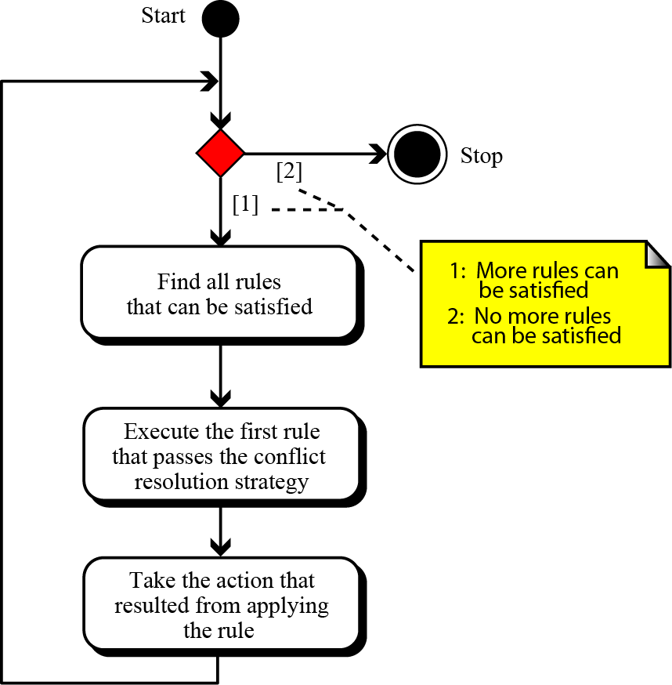
Forward chaining
Forward chaining is the process in which an interpreter uses a set of rules and a set of facts to perform an action.
Figure 18.5 Flow diagram for forward chaining

Slide 35
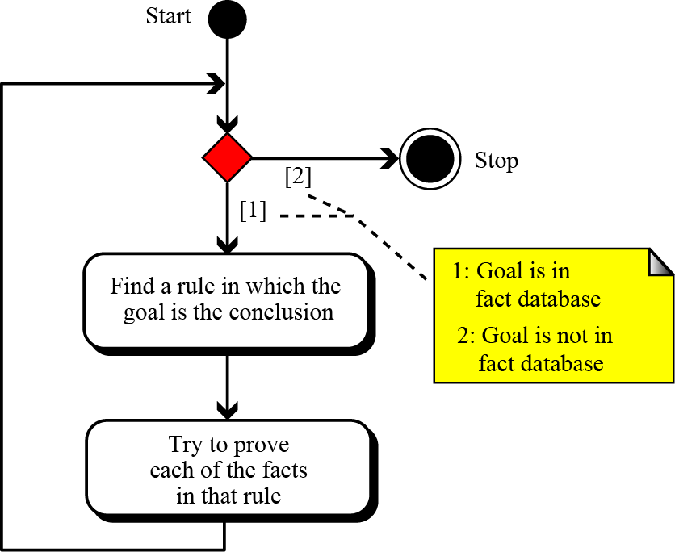
Backward chaining
Forward chaining is not very efficient if the system tries to prove a conclusion. In this cases, it may be more efficient if backward chaining is used.
Figure 18.6 Flow diagram for backward chaining

Slide 36
18-3 EXPERT SYSTEMS
Expert systems use the knowledge representation languages discussed in the previous section to perform tasks that normally need human expertise. They can be used in situations in which that expertise is in short supply, expensive, or unavailable when required. For example, in medicine, an expert system can be used to narrow down a set of symptoms to a likely subset of causes, a task normally carried out by a doctor.

Slide 37
18.3 Extracting knowledge
An expert system is built on predefined knowledge about its field of expertise. An expert system in medicine, for example, is built on the knowledge of a doctor specialized in the field for which the system is built: an expert system is supposed to do the same job as the human expert. The first step in building an expert system is therefore to extract the knowledge from a human expert. This extracted knowledge becomes the knowledge base we discussed in the previous section.

Slide 38
18.3.2 Extracting facts
To be able to infer new facts or perform actions, a fact database is needed in addition to the knowledge base for a knowledge representation language. The fact database in an expert system is case-based, in which facts collected or measured are entered into the system to be used by the inference engine.

Slide 39
18.3.3 Architecture
Figure 18.7 shows the general idea behind the architecture of an expert system. As the figure shows, an expert system can have up to seven components: user, user interface, inference
engine, knowledge base, fact database, explanation system, and knowledge base editor.
The inference engine is the heart of an expert system: it communicates with the knowledge base, fact database, and the user interface. Four of the seven components of an expert system—user interface, inference engine, explanation system, and knowledge base editor—can be made once and used for many applications, as they are not dependent on the particular knowledge base or fact database. The figure shows these components in the shaded box, normally called an expert system shell.

Slide 40
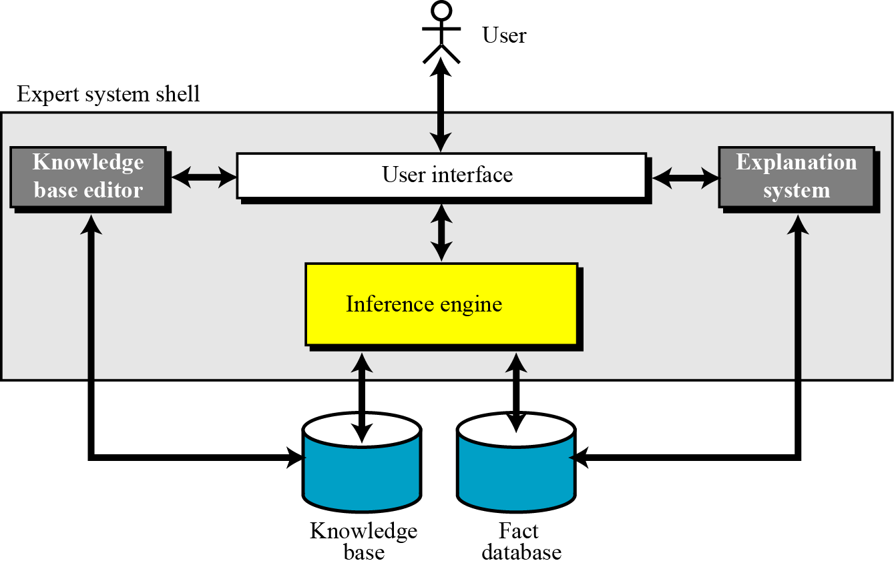
Figure 18.7 shows the general idea behind the architecture of an expert system.
Figure 18.7 The architecture of an expert system

Slide 41
User
The user is the entity that uses the system to benefit from the expertise offered.
User Interface
The user interface allows the user to interact with the system. The user interface can accept natural language from the user and interpret it for the system. Most user interfaces also offer a user-friendly menu system.
Inference engine
The inference engine is the heart of the system that uses the knowledge base and the fact database to infer the action to be taken.
Knowledge Base
The knowledge base is a collection of knowledge based on interviews with experts in the relevant field of expertise.

Slide 42
Fact database
The fact database in an expert system is case-based. For each case, the user enters the available or measured data into the fact database to be used by the inference engine for that particular case.
Explanation system
The explanation system, which may not be included in all systems, is used to explain the rationale behind the decision made by the inference engine.
Knowledge base editor
The knowledge base editor, which may not be included in all systems, is used to updatethe knowledge base if new experience has been obtained from experts in the field.

Slide 43
18-4 PERCEPTION
Another goal of AI is to create a machine that behaves like an ordinary human. One of the meanings of the word “perception” is understanding what is received through the senses—sight, hearing, touch, smell, taste. A human being sees a scene through the eyes, and the brain interprets it to extract the type of objects in the scene. A human being hears a set of voice signals through the ears, and the brain interprets it as a meaningful sentence, and so on.

Slide 44
18.4.1 Image processing
Image processing or computer vision is an area of AI that deals with the perception of objects through the artificial eyes of an agent, such as a camera. An image processor takes a two-dimensional image from the outside world and tries to create a description of the three-dimensional objects present in the scene. Although, this is an easy tasks for a human being, it turns out to be a difficult task for an artificial agent. The input presented to an image process is one or more images from the scene, while the output is a description of the objects in the scene. The processor uses a database containing the characteristics of objects for comparison.

Slide 45
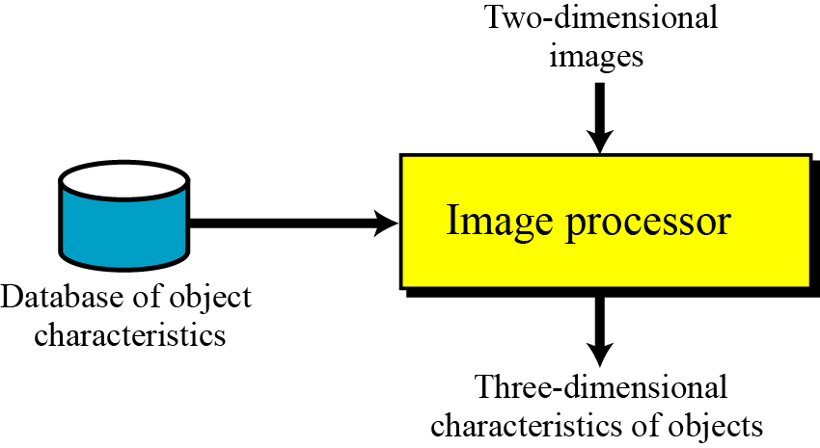
Figure 18.8 The components of an image processor

Slide 46
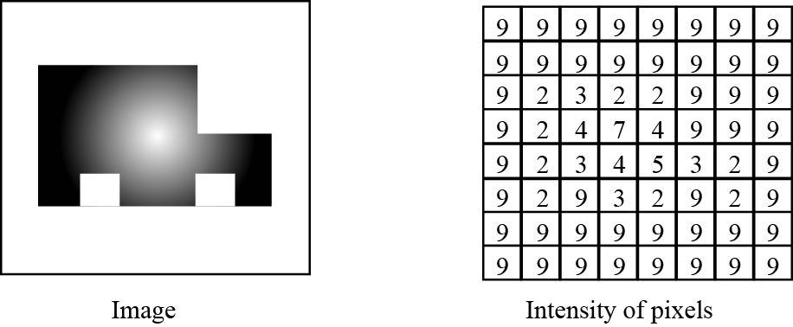
Edge detection
The first stage in image processing is edge detection: finding where the edges in the image are. Edges can define the boundaries between an object and its background in the image. Normally there is a sharp contrast between the surfaces belonging to an object and the environment, assuming that there is no camouflage.
Figure 18.9 The edge-detection process

Slide 47
Segmentation
Segmentation is the next stage in image analysis. Segmentation divides the image into homogenous segments or areas. The definition of homogeneity differs in different methods, but in general a homogenous area is an area in which the intensity of pixels varies smoothly. Segmentation is very similar to edge detection. In edge detection, the boundaries of the object and the background are found: in segmentation, the boundaries between different areas inside the object are found. After segmentation, the object is divided into different areas.

Slide 48

Finding depth
The next step in image analysis is to find the depth of the object or objects in the image. Two general methods have been used for this purpose: stereo vision and motion.
Finding orientation
Orientation of the object in the scene can be found using two techniques: shading and texture.
Figure 18.10 The effect of shading on orientation finding

Slide 49
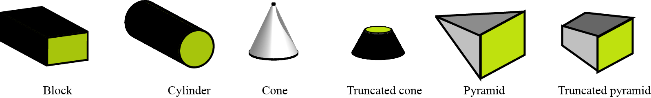
Object recognition
The last step in image processing is object recognition. To recognize an object, the agent needs to have a model of the object in memory for comparison. However, creating and storing a model for each object in the view is an impossible task. One solution is to assume that the objects to be recognized are compound objects made of a set of simple geometric shapes.
Figure 18.11 Primitive geometric shapes

Slide 50
Applications
One of the areas in which image processing has found application is in manufacturing, particularly on assembly lines. A robot with image-processing capability can be used to determine the position of an object on the assembly line. In this environment, where the number of objects to be perceived is limited, an image processor can be very helpful.

Slide 51
18.4.2 Language understanding
One of the inherent capabilities of a human being is to understand—that is, interpret—the audio signal that they perceive. A machine that can understand natural language can be very useful in daily life. For example, it can replace a telephone operator—most of the time. It can also be used on occasions when a system needs a predefined format of queries. We can divide the task of a machine that understands natural language into four consecutive steps: speech recognition, syntactic analysis, semantic analysis, and pragmatic analysis.

Slide 52
Speech recognition
The first step in natural language processing is speech recognition. In this step, a speech signal is analyzed and the sequence of words it contains are extracted. The input to the speech recognition subsystem is a continuous (analog) signal: the output is a sequence of words. The signal needs to be divided into different sounds, sometimes called phonemes. The sounds then need to be combined into words. The detailed process, however, is beyond the scope of this book: we leave the task to specialized books in speech recognition.

Slide 53
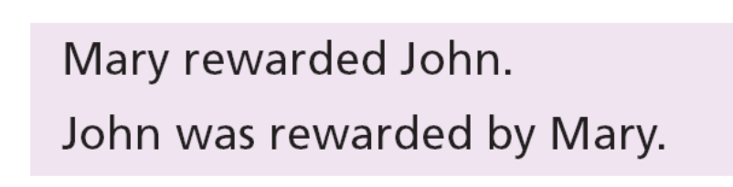
Syntactic analysis
The syntactic analysis step is used to define how words are to be grouped in a sentence. This is a difficult task in a language like English, in which the function of a word in a sentence is not determined by its position in the sentence. For example, in the following two sentences:
it is always John who is rewarded, but in the first sentence John is in the last position and Mary is in the first position. A machine that hears any of the above sentences needs to interpret them correctly and come to the same conclusion no
matter which sentence is heard.

Slide 54
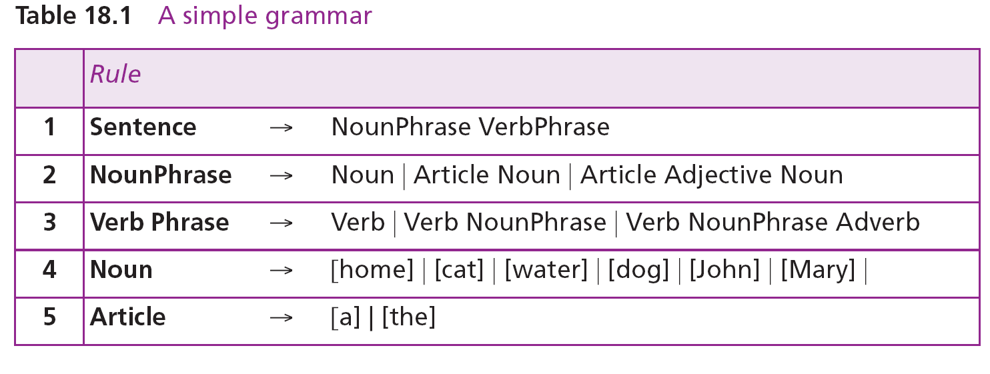
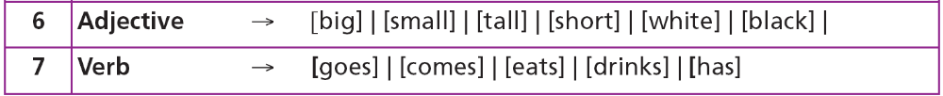
Grammar
The first tool to correctly analyze a sentence is a well-defined grammar. We use a simple version of BNF (Backus-Naur Form) that is used in computer science to define the syntax of a programming language (Table 18.1).

Slide 55
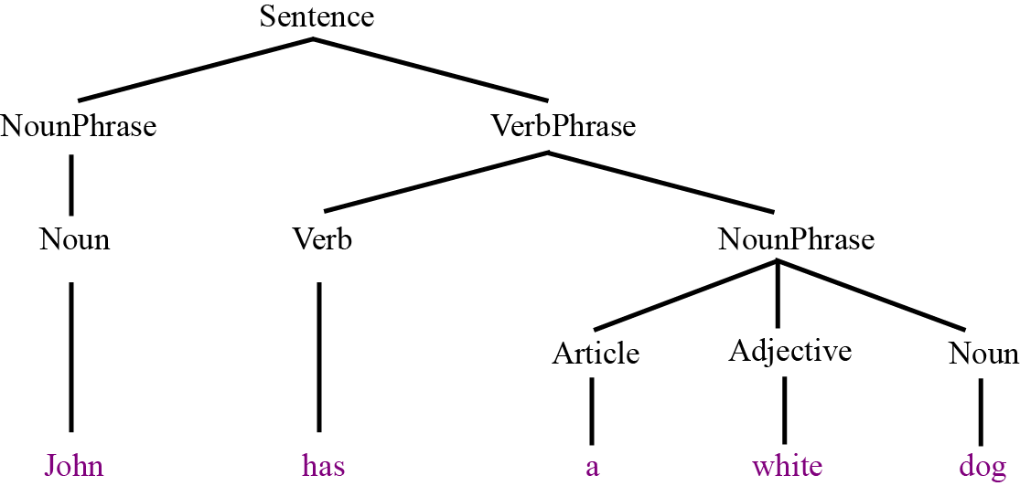
Parser
It should be clear that even a simple grammar as defined in Table 18.1 uses different options. A machine that determines if a sentence is grammatically (syntactically) correct does not need to check all possible choices before rejecting a sentence as an invalid one. This is done by a parser.
Figure 18.12 Parsing a sentence

Slide 56
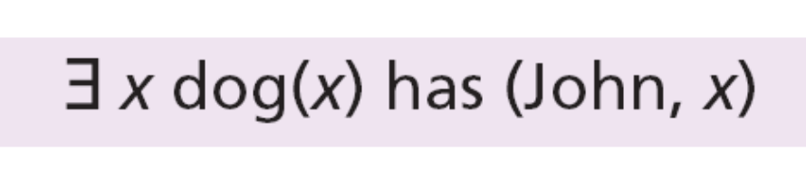
Semantic analysis
The semantic analysis extracts the meaning of a sentence after it has been syntactically analyzed. This analysis creates a representation of the objects involved in the sentence, their relations, and their attributes. The analysis can use any of the
knowledge representation schemes we discussed before. For example, the sentence “John has a dog” can be represented using predicate logic as:

Slide 57
Pragmatic analysis
The three previous steps—speech recognition, syntax analysis, and semantic analysis— can create a knowledge representation of a spoken sentence. In most cases,
another step, pragmatic analysis, is needed to further clarify the purpose of the sentence and to remove ambiguities.
18.<number>

Slide 58
18-5 SEARCHING
One of the techniques for solving problems in artificial intelligence is searching, which is discussed briefly in this section. Searching can be describe as solving a problem using a set of states (a situation). A search procedure starts from an initial state, goes through intermediate states until finally reaching a target state. For example, in solving a puzzle, the initial state is the unsolved puzzle, the intermediate states are the steps taken to solve the puzzle, and the target state is the situation in which the puzzle is solved. The set of all states used by a searching process is referred to as the search space.

Slide 59
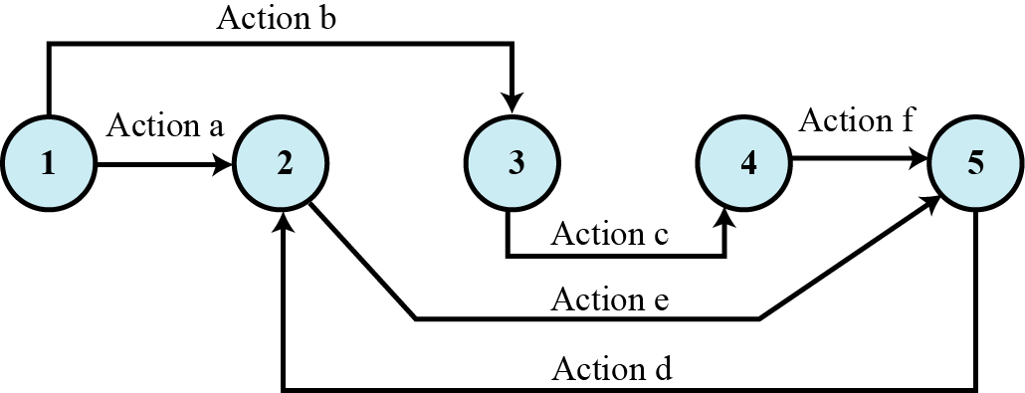
Figure 18.13 An example of a search space

Slide 60
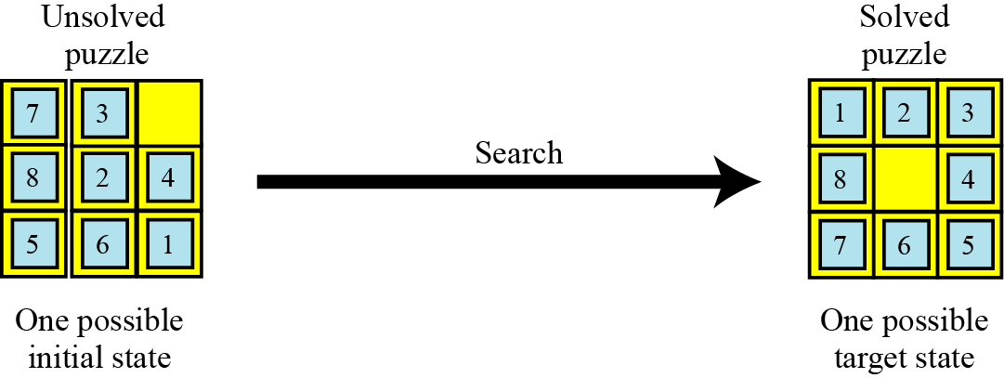
Example 18.6
One example of a puzzle that shows the search space is the famous 8-puzzle. The tiles are numbered from 1 to 8. Given an initial random arrangement of the tiles (the initial state), the goal is to rearrange the tiles until a ordered arrangement of the tiles is reached (the target state). The rule of the game is that a tile can be slid into an empty slot.
Figure 8.14 A possible initial and final state for Example 18.6

Slide 61
18.5.1 Search methods
There are two general search methods: brute-force and heuristic. The brute force method is itself either breadth-first or depth first
Brute-force search
We use brute-force search if we do not have any prior knowledge about the search. For example, consider the steps required to find our way through the maze in Figure 18.15 with points A and T as starting and finishing points respectively. The tree diagram for the maze is shown in Figure 18.16.

Slide 62
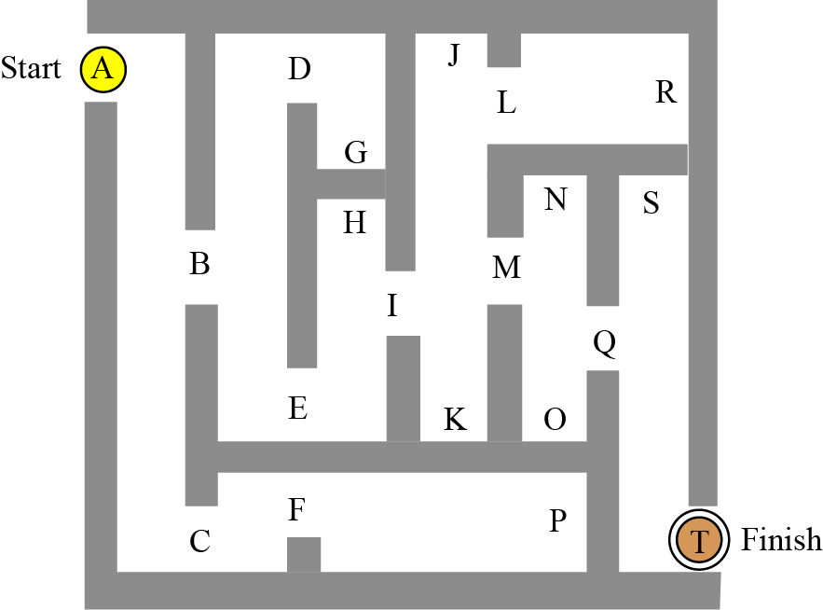
Figure 18.15 A maze used to show brute force search

Slide 63
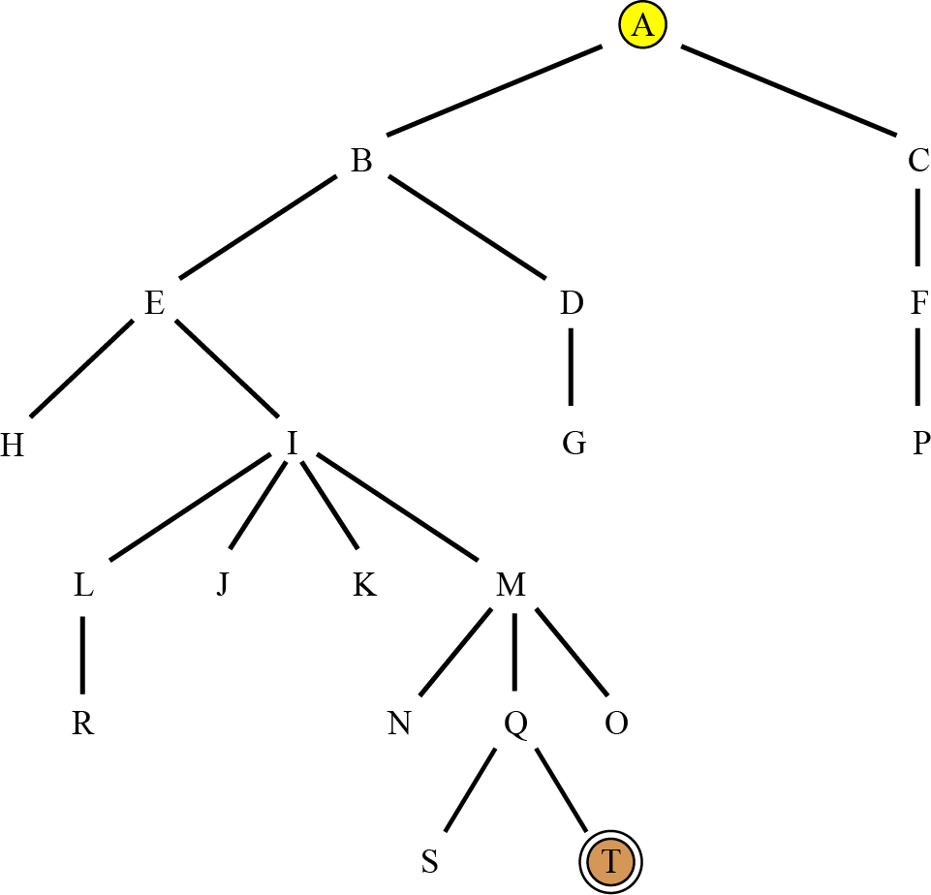
Figure 18.16 The tree for the maze in Figure 18.15

Slide 64
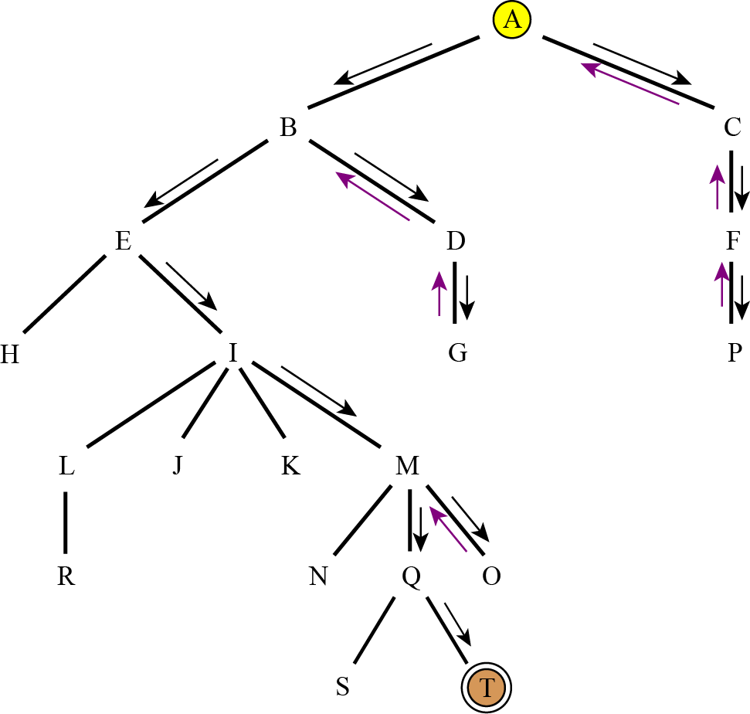
Figure 18.17 Depth-first search of the tree in Figure 18.16

Slide 65
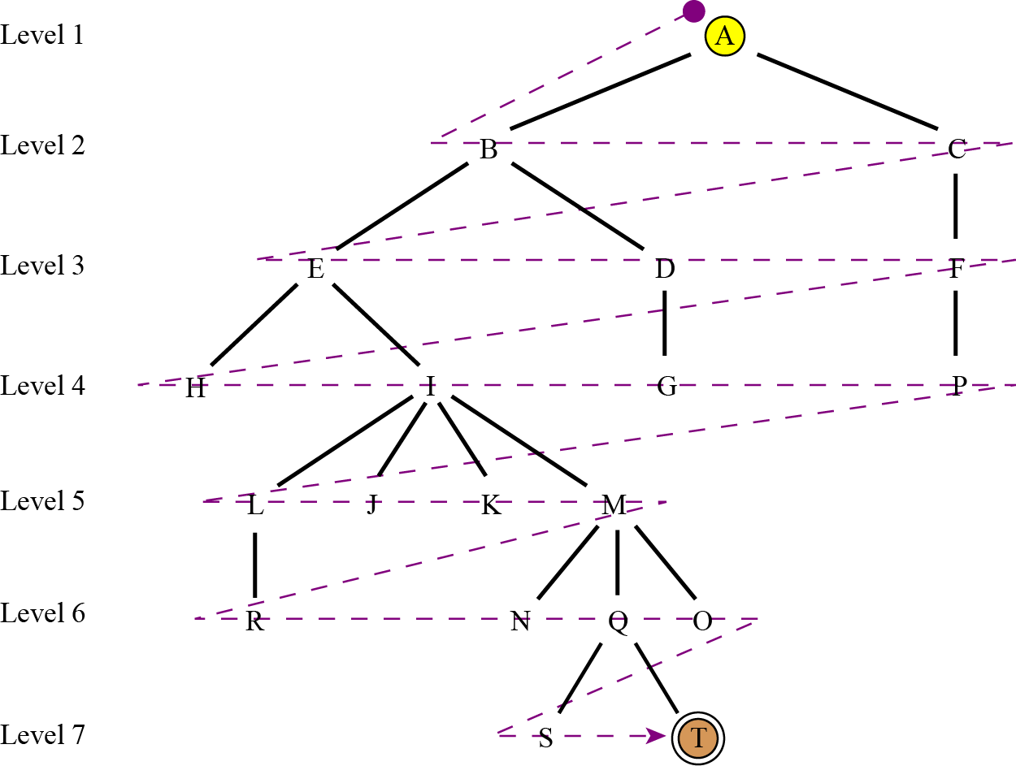
Figure 18.18 Breadth-first search of the tree in Figure 18.16

Slide 66
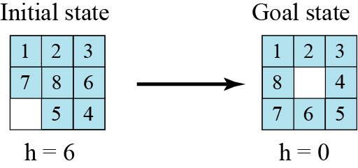
Heuristic search
Using heuristic search, we assign a quantitative value called a heuristic value (h value) to each node. This quantitative value shows the relative closeness of the node to the goal state. For example, consider solving the 8-puzzle of Figure 18.19.
Figure 18.19 Initial and goal states for heuristic search

Slide 67
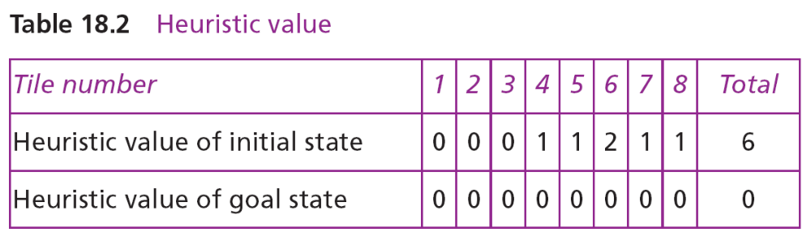
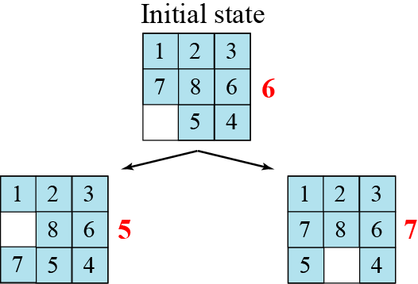
Figure 18.20 The heuristic values for the first step

Slide 68
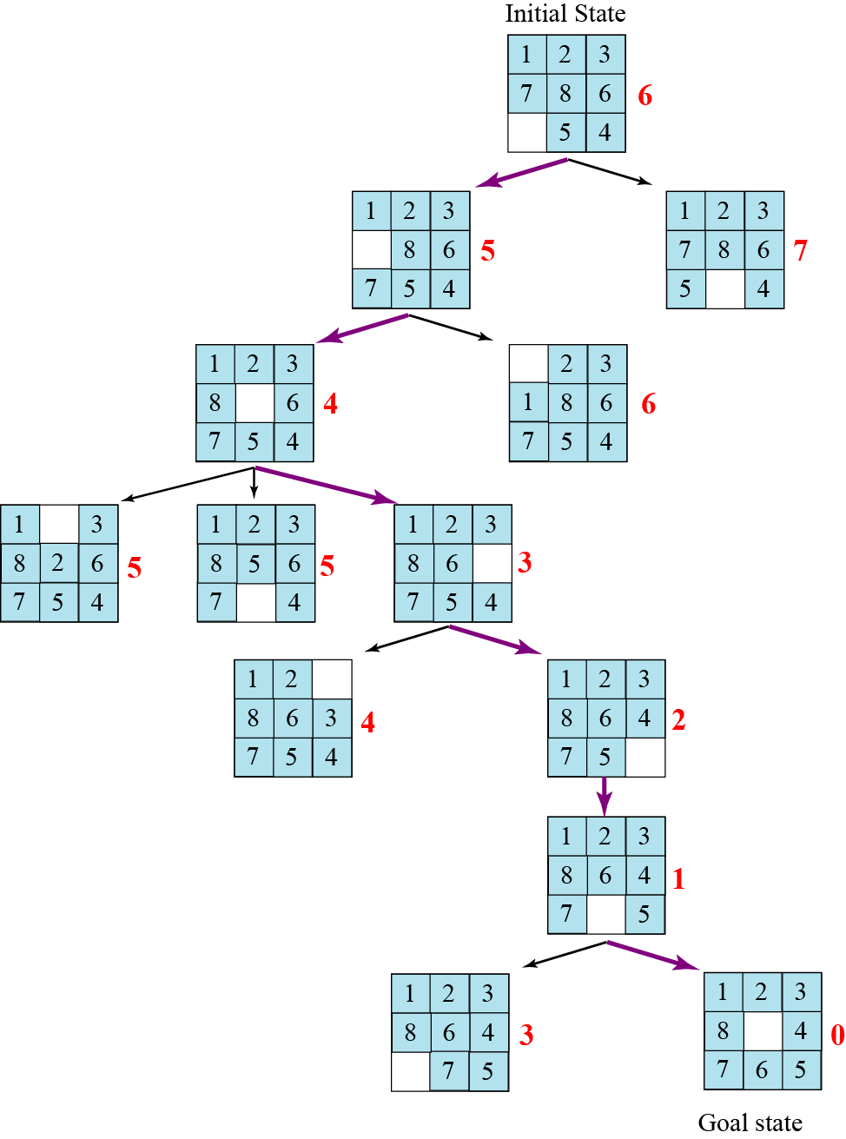
Figure 18.21 Heuristic search for solving the 8-puzzle

Slide 69
18-6 NEURAL NETWORKS
If an intelligent agent is supposed to behave like a human being, it may need to learn. Learning is a complex biological phenomenon that is not even totally understood in humans. Enabling an artificial intelligence agent to learn is definitely not an easy task. However, several methods have been used in the past that create hope for the future. Most of the methods use inductive learning or learning by example. This means that a large set of problems and their solutions is given to the machine from which to learn. In this section we discuss only neural networks.

Slide 70
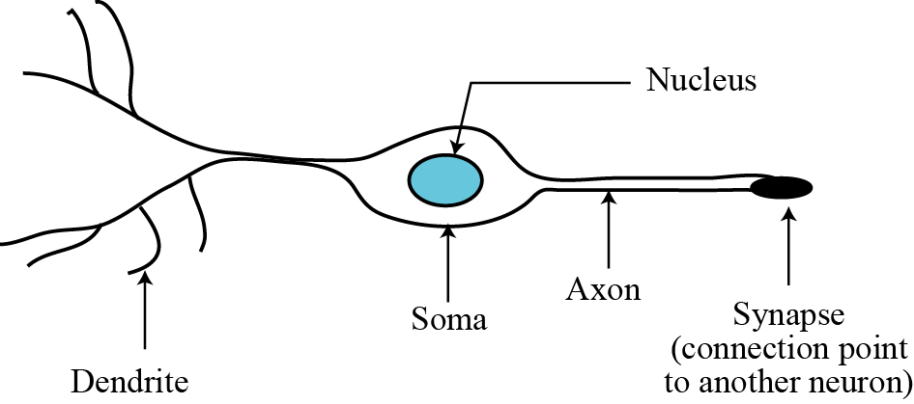
18.6.1 Biological neurons
The human brain has billions of processing units, called neurons. Each neuron, on average, is connected to several thousand other neurons. A neuron is made of three part: soma, axon, and dendrites, as shown in Figure 18.22.
Figure 18.22 A simplified diagram of a neuron

Slide 71
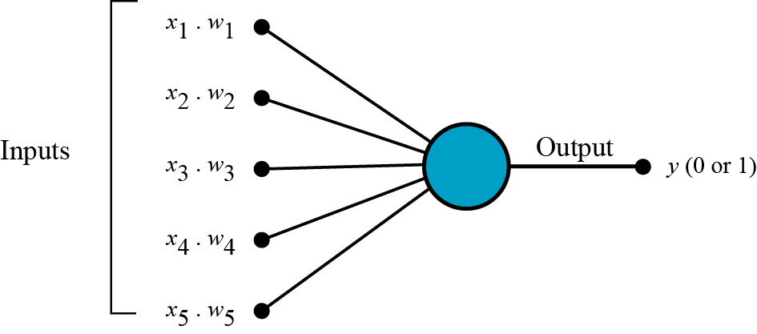
18.6.2 Perceptrons
A perceptron is an artificial neuron similar to a single biological neuron. It takes a set of weighted inputs, sums the inputs, and compares the result with a threshold value. If the result is above the threshold value, the perceptron fires, otherwise, it does not. When a perceptron fires, the output is 1: when it does not fire, the output is zero.
Figure 18.23 A perceptron

Slide 72
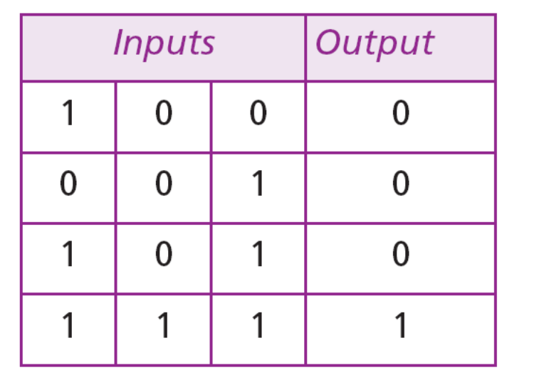
Example 18.7
Assume a case study with three inputs and one output. There are already four examples with known inputs and outputs, as shown in the following table:
This set of inputs is used to train a perceptron with all equal weights (w₁ = w₂ = w₃). The threshold is set to 0.8. The original weight for all inputs is 50%. The weights remain the same if the output produced is correct—that is, matches the actual output.

Slide 73
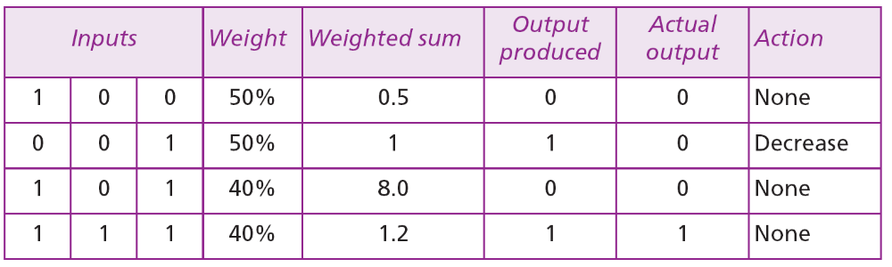
The weights are increased by 10% if the output produced is less than the output data: the weights are decreased by 10% if the output produced is greater than the output data. The following table shows the process of applying the previous established examples to train the perceptron.

Slide 74
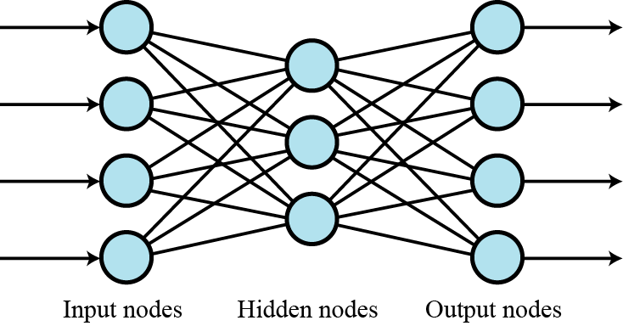
18.6.3 Multi-layer networks
Several layers of perceptions can be combined to create multilayer neural networks. The output from each layer becomes the input to the next layer. The first layer is called the input layer, the middle layers are called the hidden layers, and the last layer is called the output layer.
Figure 18.24 A multi-layer neural network

Slide 75
18.6.4 Applications
Neural networks can be used when enough pre-established inputs and outputs exist to train the network. Two areas in which neural networks have proved to be useful are optical character recognition (OCR), in which the intelligent agent is supposed to read any handwriting, and credit assignment, where different factors can be weighted to establish a credit rating, for example for a loan applicant.

